Slide 1

How the Internet is Useful
PRESENTED BY
IHTESAM UL HAQ
Akhuwat F.I.R.S.T

Slide 2
INTRODUCTION
The basic understanding of a lay man about the internet is “What kind of information is available on the internet and how. Before 1998 ’ people used of think about internet as having onley one Sepcific segment i.e. But actually the internet has many more components of immense utilization

Slide 3
KEY pointes
World Wide web (www)
Electroniec mail (e mail)
Telnet
File Transfer Protocol (FTP)
. Gopher
Intranet
Extranent

Slide 4
Key points
Chat grupes
Intranet
Extranent

Slide 5

World Wide Web(www)
WWW is a collection of millions uploading web pages /web sides it organizes the internet related resources so that we can easily accsess the information available on the in

Slide 6

Electronice male
As defined earlier it is the process of sending and receving
messages and files among the internet users.

Slide 7
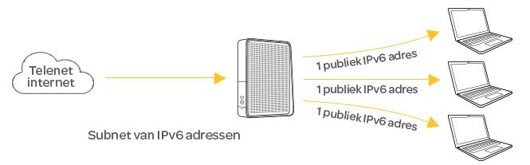
telnet
It is the software tool that allows one computer to connect another compouter and use of the other ompouters information.

Slide 8
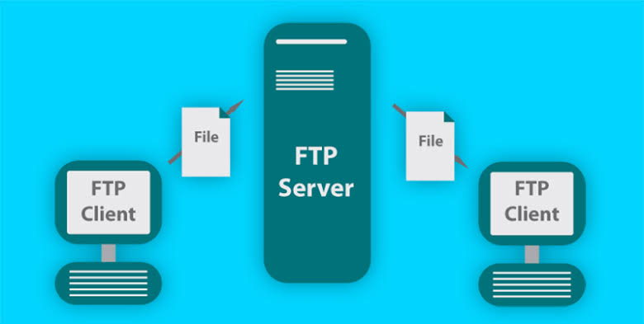
File transfer protocol
It is also an intrnet software tool for transferring files for one compouter to another.

Slide 9

ghopher
It is an access and retrieval system covering a wide range of information.

Slide 10

Chat groups
The internet users with similar interests from up there forums to have online real time discussion over the internet.

Slide 11
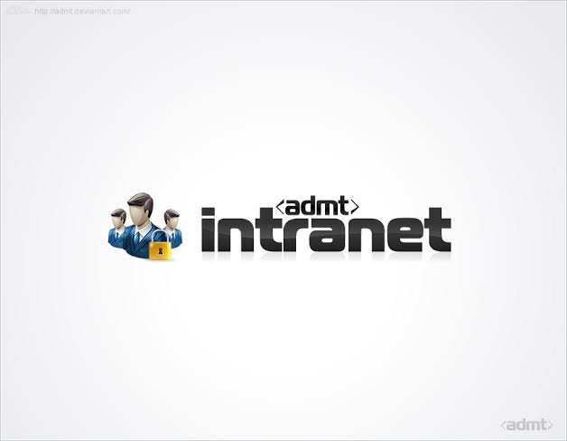
intranet
An intranet is a privately owned secure business network based on intranet technology although not necessarily connected to the intranet.

Slide 12

Extranet
An extranet is two or more intranets connected in such a way that they enable collaboration among the companies that own the separate intranets.

Slide 13


